Slide 1
Chapter 8 – Single sample hypothesis tests

Slide 2
Outline
Hypotheses and test procedures
Tests About a Population Mean
Tests Concerning a Population Proportion
P-values

Slide 3
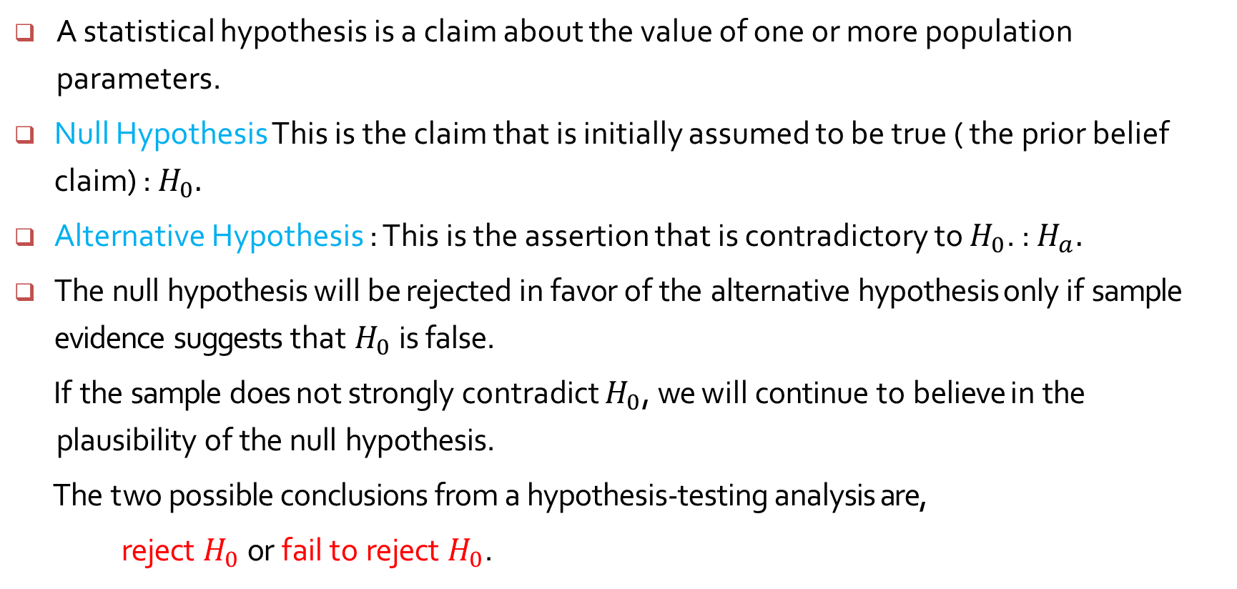
Statistical Hypotheses
A statistical hypothesis is a claim about the value of one or more population parameters.
Null Hypothesis This is the claim that is initially assumed to be true ( the prior belief claim) : $H_{0}.$
Alternative Hypothesis : This is the assertion that is contradictory to $H_{0}$. : $H_{a}.$
The null hypothesis will be rejected in favor of the alternative hypothesis only if sample evidence suggests that $H_{0}$ is false.
If the sample does not strongly contradict $H_{0}$, we will continue to believe in the plausibility of the null hypothesis.
The two possible conclusions from a hypothesis-testing analysis are,
reject $H_{0}$ or fail to reject $H_{0}$.

Slide 4
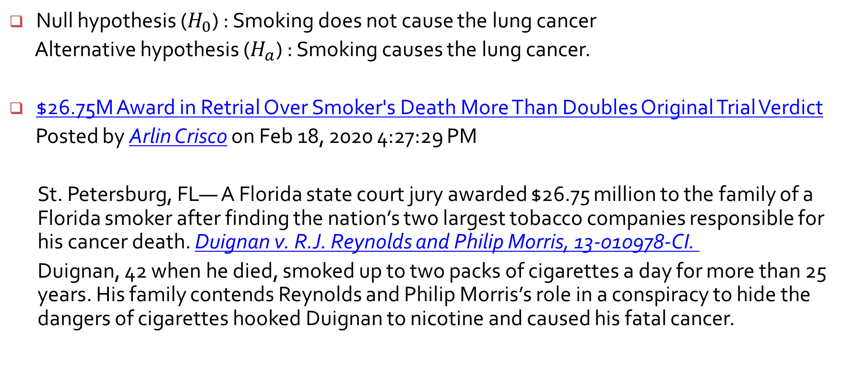
Smoking example
Null hypothesis ($H_{0}$) : Smoking does not cause the lung cancer
Alternative hypothesis ($H_{a}$) : Smoking causes the lung cancer.
$26.75M Award in Retrial Over Smoker's Death More Than Doubles Original Trial Verdict
Posted by Arlin Crisco on Feb 18, 2020 4:27:29 PM
St. Petersburg, FL— A Florida state court jury awarded $26.75 million to the family of a Florida smoker after finding the nation’s two largest tobacco companies responsible for his cancer death. Duignan v. R.J. Reynolds and Philip Morris, 13-010978-CI.
Duignan, 42 when he died, smoked up to two packs of cigarettes a day for more than 25 years. His family contends Reynolds and Philip Morris’s role in a conspiracy to hide the dangers of cigarettes hooked Duignan to nicotine and caused his fatal cancer.

Slide 5
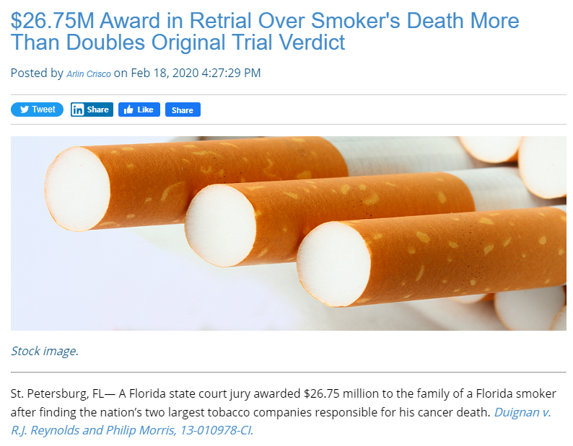

Slide 6
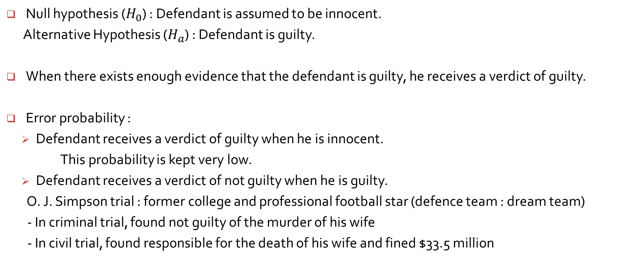
Court example
Null hypothesis ($H_{0}$) : Defendant is assumed to be innocent.
Alternative Hypothesis ($H_{a}$) : Defendant is guilty.
When there exists enough evidence that the defendant is guilty, he receives a verdict of guilty.
Error probability :
Defendant receives a verdict of guilty when he is innocent.
This probability is kept very low.
Defendant receives a verdict of not guilty when he is guilty.
O. J. Simpson trial : former college and professional football star (defence team : dream team)
- In criminal trial, found not guilty of the murder of his wife
- In civil trial, found responsible for the death of his wife and fined $33.5 million

Slide 7
